Slide 1
Amazon Sales Data Insights
Quarter 1, 2019 – January to March
Location: Myanmar (Yangon, Mandalay, Naypyitaw)

Slide 2
Business Objective
Amazon has been operating it’s stores across three branches in Myanmar over the years.
These are spread across Yangon, Mandalay and Naypyitaw.
The major aim of this data analysis project is to:
Gain insight into the sales data of Amazon across these stores
Understand the different factors that affect sales of the different branches
Understand the performance of Product Lines in Myanmar
Understand Customer Dynamics across the branches
Provide recommendations on how the sales could be improved in each of these branches
Tools used for Data Analysis: MySQL Workbench (please find the SQL file attached in the zip folder)
1. Data analysis in this deck has been done using MySQL Workbench and the dataset provided

Slide 3
Flow of the Analysis
Product Analysis & Insights
Sales Analysis & Insights
Customer Analysis & Insights
Recommendations

Slide 4
Flow of the Analysis
Product Analysis & Insights
Sales Analysis & Insights
Customer Analysis & Insights
Recommendations

Slide 5
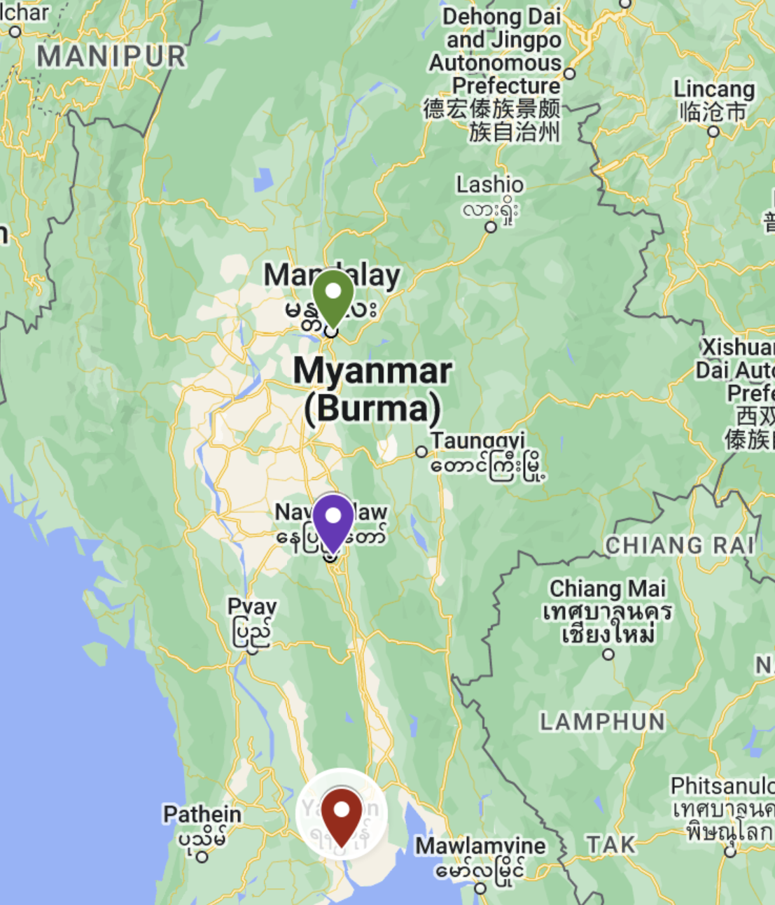
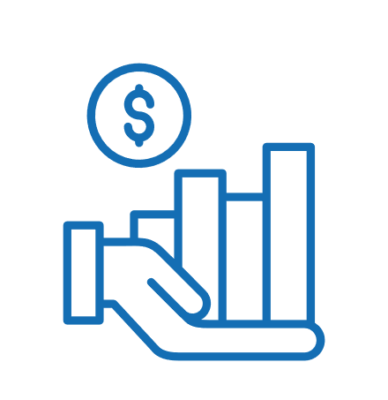
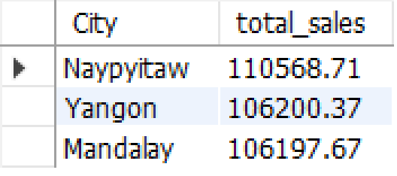
The capital Naypyitaw recorded the highest sales across all the product lines
There are 6 distinct product lines in the stores across the 3 centres in Myanmar:
Health and Beauty
Electronic accessories
Home and lifestyle
Sports and travel
Food and beverages
Fashion accessories
Total Sales in Myanmar:
MMK 322,966.75
City-wise Sales:

Slide 6
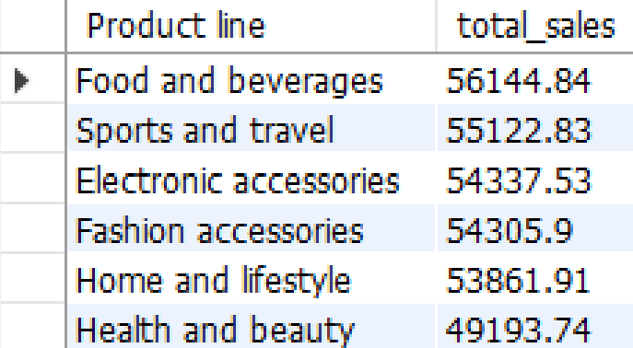
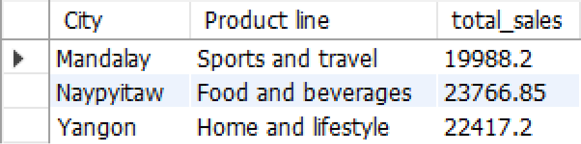
While F&B recorded highest sales, Health & Beauty sales could be improved
Sales across Product Lines:
Insights:
Food and Beverages recorded the highest sales of MMK 56,144.84 across Jan’19 – Mar’19
This was closely followed by Sports and travel, and Electronic accessories
Continue to strengthen the marketing for these top 3 product lines, as that would ensure consistent sales figures
Health and beauty recorded the least sales, and there is a potential for ramping up marketing strategies to improve sales for this product line
City-wise Top Product Lines by Total Sales:

Slide 7
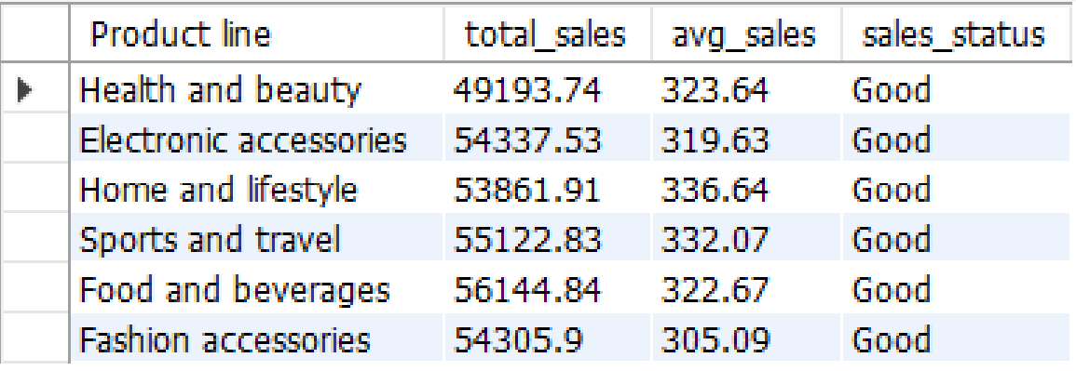
Sales across all product lines were recorded above average – this is Good
Sales Status (Good / Bad as per average Sales in that Product line):
Insights:
Food and Beverages registered a Total (and highest) VAT of MMK 2673.56 among the 6 Product Lines in Myanmar
The sales status was “Good” for all the product lines as total sales was higher than average sales for all of them
*Sales recorded across all the centers and product lines in each of them were ‘Good’.
This indicates that above average sales have been achieved with the current marketing strategies.
Enhance and / or continue existing marketing and brand strategies as they are driving sales across these stores in Myanmar.
*See Q #5 in the SQL Workbench file – within Product Analysis query file

Slide 8
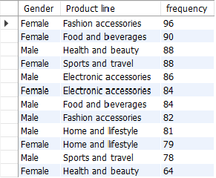
H&B could be significantly improved by targeting females, the predominant purchasers
Gender vs. Product line distribution of purchases:
Insights:
Females are the predominant purchasers across Fashion Accessories and Food and beverages product lines, possibly because they are usually the primary decision-makers on these categories
Compared to females, health and beauty product line attracts more males
Females could be easily targeted in marketing strategies for the categories within Health and Beauty too
This would ensure building the product line, since most of the purchasers are anyway female
*See Q #5 in the SQL Workbench file – within Product Analysis query file

Slide 9
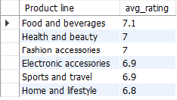
F&B recorded the highest average ratings across all PLs; need to improve ratings for Home and Lifestyle
Average Rating by Product Line:
Insights:
The highest average rating has been for food and beverages, while the lowest has been for Home and lifestyle product lines
However these are not significant differences in average ratings, therefore all the product lines are performing well
Focus could be given to improving marketing, services, products and ratings in electronic accessories, sports and travel and home and lifestyle product lines
*See Q #5 in the SQL Workbench file – within Product Analysis query file

Slide 10
Flow of the Analysis
Product Analysis & Insights
Sales Analysis & Insights
Customer Analysis & Insights
Recommendations

Slide 11

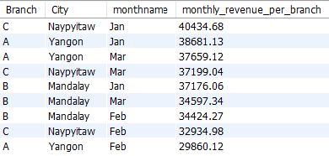
While Jan’19 is the star month of the Q1’2019, February registered lower revenues
Monthly Revenue/Sales generated in Q1 2019:
Insights:
Jan 2019 recorded the highest revenue in Q1 2019 across all branches in Myanmar
Mandalay branch performs consistently across all the three months, but this could be improved
Branches C and A (Naypyitaw and Yangon respectively) tend to fall short on sales in February inspite of performing well in Jan and March
Branch-wise Monthly Revenue/Sales generated in Q1 2019:
Consider improving sales in February for Branches C and A by modifying discount strategies across all the product lines

Slide 12

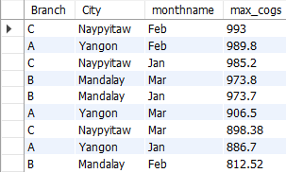
February also recorded higher production costs, indicating a need to strategize better to ensure profitability
Insights:
February recorded the maximum cost of production (COGS) – attributable to the Branches C and A of Naypyitaw and Yangon. Since revenues were low in this month, the COGS (production costs) are higher indicating lesser profitability
On the other hand, Mandalay branch recorded the least production expenses in February
Monthly Max Cost of Goods Sold (COGS) in Q1 2019:
Branch-wise Max COGs generated in Q1 2019:
Since having discounts in February could potentially increase the COGS, other strategies like market expansion, product diversification, negotiating with suppliers, improving operational efficiencies, investing in technologies, supplier diversification, customer retention, and sales effectiveness could be used instead

Slide 13
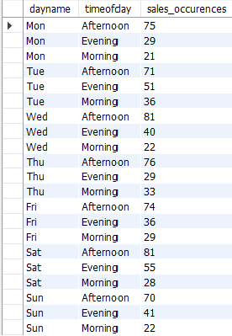
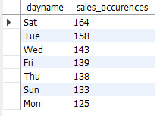
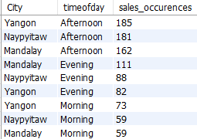

Most sales occur on Sat, Tues, Wed – predominantly in the Afternoons and Evenings
Sales Occurrences across the Day & Time of Day:
Insights:
Overall, most sales across occur on Saturday, Tuesday and Wednesday
Sales primarily occur in the Afternoon and least of all in the morning across all branches
Afternoon is also the time when customers provide the most ratings
Direct most sales and marketing efforts in the afternoon to evening time-frame for increasing sales in the region

Slide 14
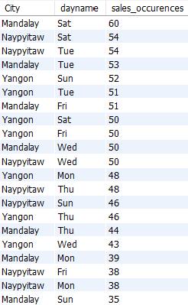
Branch-wise: Sat, Tues, Sun and Friday registered peak sales transactions making these days suitable for critical marketing efforts
Insights:
Saturday, Tuesday, Sunday and Friday are the days where the highest number of sales were recorded by the three branches in Yangon, Naypyitaw and Mandalay
Sales Occurrences across Centers:
The above mentioned days are the most critical for launching sales and marketing efforts such as discounts, membership/loyalty programs, etc.
Coupled with timing this during the Afternoon-Evening span, it would help boost overall sales and raise profits

Slide 15
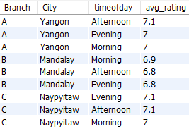

Being peak sales hours, Afternoons and Evenings recorded the highest average ratings from customers across Myanmar branches
Insights:
Average customer rating recorded are the highest during afternoon and evening – the peak hours of sales
Although the Mandalay branch has consistent sales, its ratings are marginally lesser than those of the Yangon and Naypyitaw branches
Time of day with highest ratings for each branch:
Ratings could be improved further by improving product quality and service for all the centers
Efforts need to be taken to improve the customer experience and ratings of the Mandalay branch to bring it on par with the Yangon and Naypyitaw branches
Day with the Highest Average Rating:
MONDAY : 7.2

Slide 16
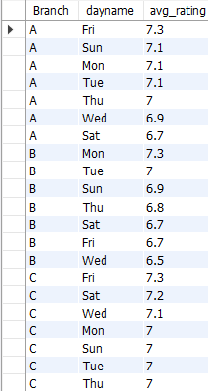
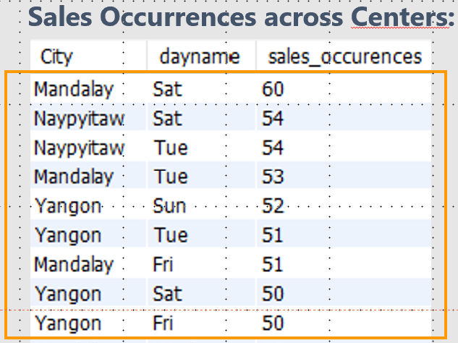
Focus should be given to improve ratings on the days with highest recorded sales
Insights:
Branch A (Yangon) recorded the highest average rating on Friday
Branch B (Mandalay) recorded the highest average rating on Monday
Branch C (Naypyitaw) recorded the highest average rating on Friday
Day with highest ratings for each branch:
Focus on improving ratings on these days where sales occurrences are highest
Average ratings could be appearing high on certain days such as Monday due to lower sales recorded on those days
Focus should be given to improve ratings on the days where the highest sales are recorded

Slide 17
Flow of the Analysis
Product Analysis & Insights
Sales Analysis & Insights
Customer Analysis & Insights
Recommendations

Slide 18


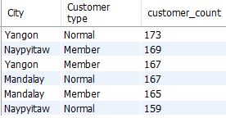

Members are marginally predominant in customer types; scope for further conversions within customer types exists
Customer Types contributing to Revenue:
Insights:
There are two distinct customer types – Member and Normal
Naypyitaw has the most Members, while Yangon has the most Normal customer types
Highest VAT Percentage - Naypyitaw:
Customer Type with Highest VAT payments:
Member : MMK 7820.16
Drive strategies to improve conversion to membership for normal customer types further within Yangon and Mandalay

Slide 19

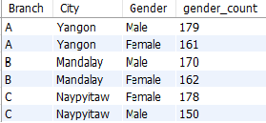

Customer Profile: Important to build sales across both customer groups (Males and Females)
Customer Profile:
Insights:
Females are marginally predominant customers across Myanmar, however males are not far behind (501:499 split)
Given the sales and product analysis insights, it would be important to target and develop sales across both these customer groups (Males and Females) to drive sales
Females are marginally the Predominant Customers
Distribution of Genders within each branch:
Target Females for building product lines like Health and Beauty and driving sales within them
Drive marketing strategies that cater to both genders equally for all-round growth in sales
Genders contributing to Total Sales:

Slide 20
Flow of the Analysis
Product Analysis & Insights
Sales Analysis & Insights
Customer Analysis & Insights
Recommendations

Slide 21


Summary
Recommendations
F&B recorded the highest sales; there is scope for improving the sales for H&B
Sales are “Good” across the board: with Total higher than Average sales
F&B ratings are highest, with scope for improving ratings for Home and Lifestyle
Feb’19 recorded lowest revenues and higher COGS, indicating lower profitability
Saturday, Sunday, Tuesday and Friday recorded the most sales occurrences across the different branches
Afternoon and Evenings are the key times of the day most sales occur
While most customers are members, there are high numbers of normal customers too – indicating there is scope to convert normal customers to members
Strategize to pull females into purchasing H&B products, since this category actually caters a lot more to females than men usually
Drive strategies to improve ratings across the PLs by targeting sales & marketing efforts on peak sales days (Sat, Sun, Tues, Fri) during the afternoons and evenings
Such strategies would also maximize sales and thus profitability, across the branches in Myanmar
Since having discounts in February could potentially increase the COGS, other strategies like market expansion, product diversification, negotiating with suppliers, improving operational efficiencies, investing in technology, supplier diversification, customer retention, and sales effectiveness could be used to increase profitability instead of discounts during this month
Convert normal customers to members by providing them with appealing incentives and discounts – such as initial 3 months free membership.

Slide 22
Thank You Analyst: Rachana Gupta | S8237 | DS41A

